Slide 1
Admitted student day
Looking at the Summer Ahead…

Slide 2
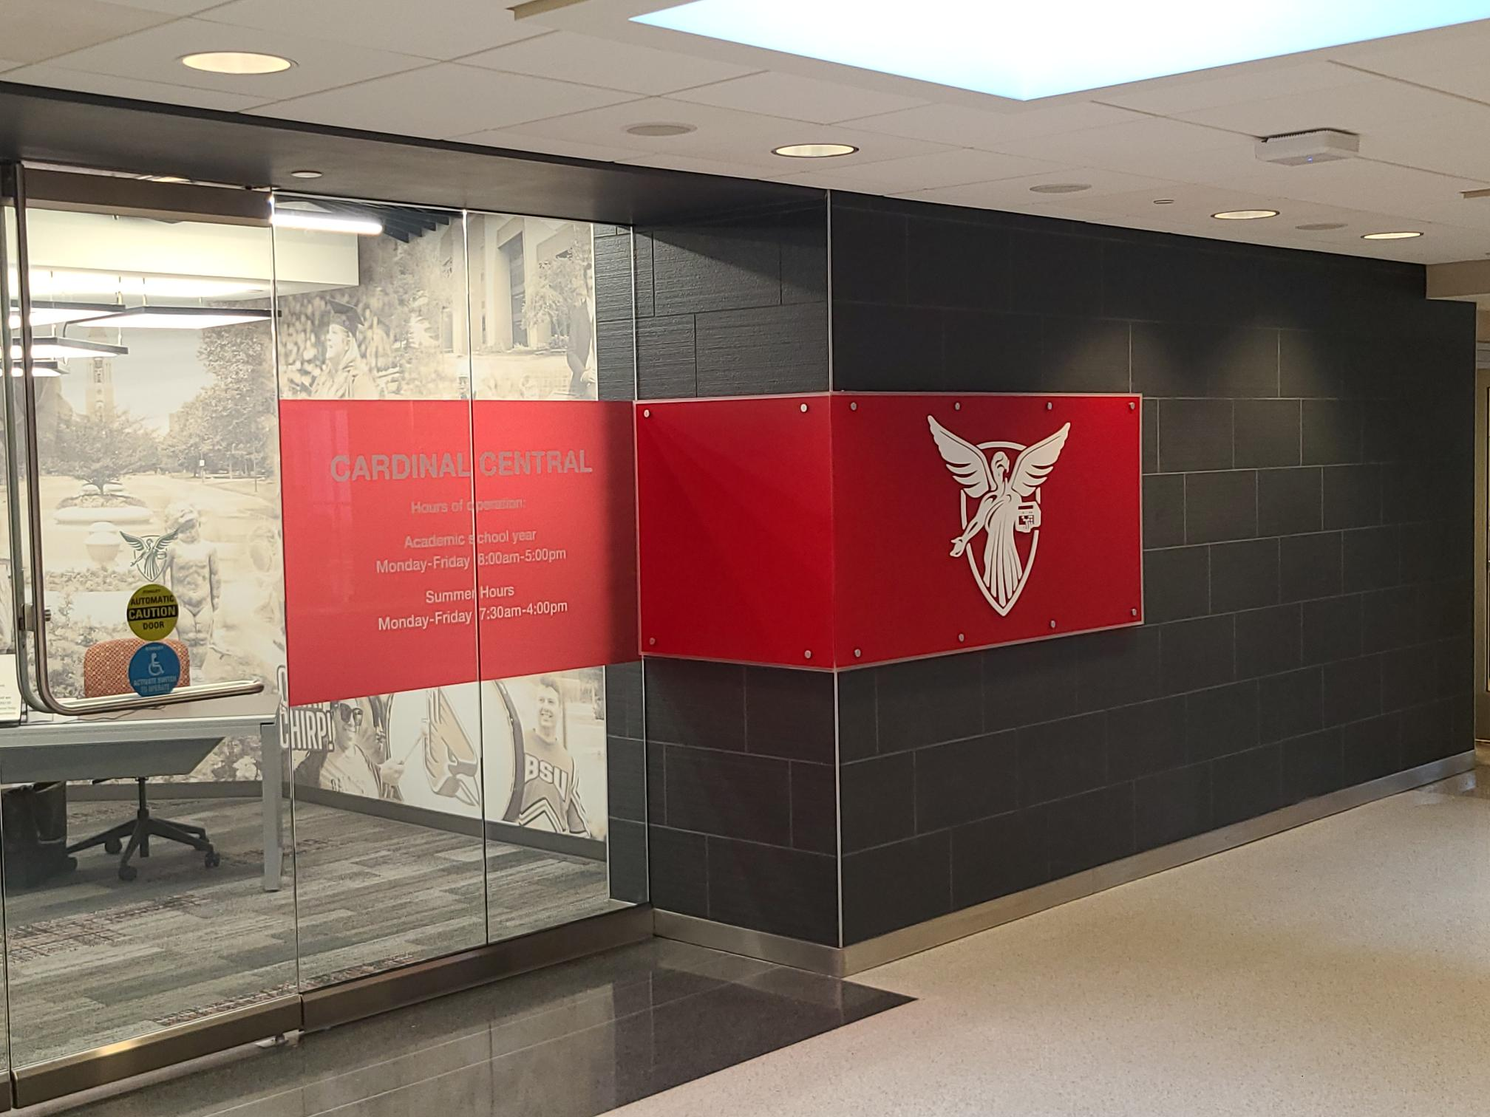
What you need to know
Cardinal Central
“Supporting the Business of Being a Student”
cardinalcentral@bsu.edu
bsu.edu/cardinalcentral
Cardinal Central
Admitted Student Day 2024

Slide 3
What you need to know
Cardinal Central
“Supporting the Business of Being a Student”
cardinalcentral@bsu.edu
STOP BY AND SEE US! STUDENT CENTER
ROOM 120
ACROSS FROM STARBUCKS
bsu.edu/cardinalcentral
Cardinal Central
Admitted Student Day 2024

Slide 4
WHAT YOU NEED TO KNOW
BILLING QUESTIONS
FINANCIAL AID QUESTIONS
REGISTRATION QUESTIONS
CARDINAL CENTRAL
Cardinal Central
Admitted Student Day 2024

Slide 5
HOW MUCH IT COST
TUITION & FEES HOUSING & FOOD
BOOKS & SUPPLIES TRANSPORTATION & MISC.
BILLABLES
NON-BILLABLES
Cardinal Central
Admitted Student Day 2024

Slide 6
HOW MUCH IT COST
TUITION & FEES HOUSING &FOOD
+
BOOKS & SUPPLIES TRANSPORTATION & MISC ______________________
COST OF ATTENDANCE
IN-STATE ESTIMATE: $27,602 / OUT-OF-STATE ESTIMATE: $47,050
PER SEMESTER ESTIMATE: 13,801 PER SEMESTER ESTIMATE: 23,525
Cardinal Central
Admitted Student Day 2024

Slide 7
HOW TO PAY FOR IT
FINANCIAL AID
Scholarships
Grants
Loans
Veteran’s Benefits
Work Study
SELF PAY
Cash/Check Payments
Payment Plan Option
529 Plans
Authorized Payers
Guest Payers
Cardinal Central
Admitted Student Day 2024

Slide 8
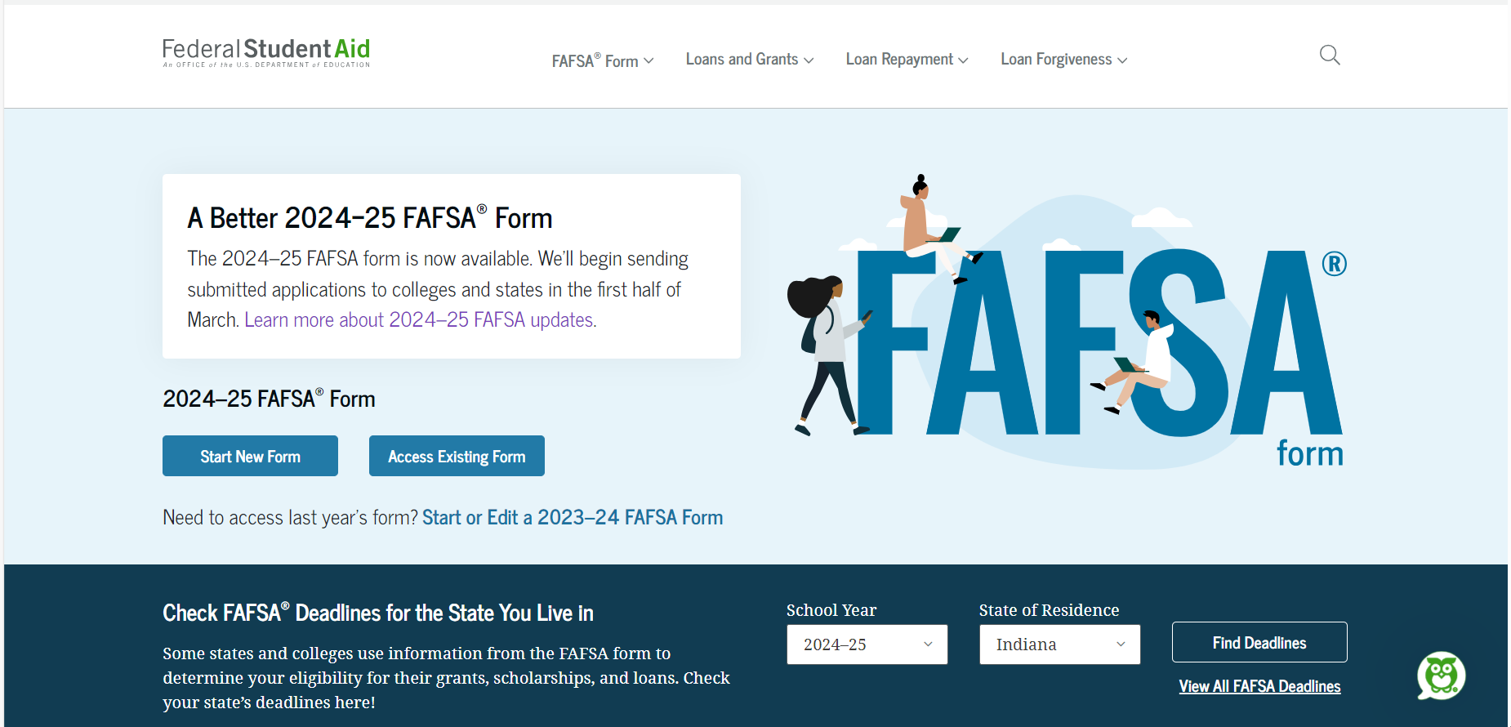
HOW TO PAY FOR IT
www.studentaid.gov
Cardinal Central
Admitted Student Day 2024

Slide 9
HOW TO PAY FOR IT
Ball State Grant
Pell Grant & Federal Loans
21st Century Scholars
FAFSA
PRIVATE OPTIONS MAY OR MAY NOT REQUIRE A FAFSA TO BE COMPLETED
Cardinal Central
Admitted Student Day 2024

Slide 10
HOW TO PAY FOR IT
vetbenefits@bsu.edu
ALL MILITARY AID RECIPIENTS SHOULD EMAIL TO VERIFY AND VALIDATE DEADLINES
Cardinal Central
Admitted Student Day 2024

Slide 11
SUMMER TIMING
APRIL – MAY
FAFSA confirmed
Proxy / Authorized Payer
Direct Deposit Setup
Financial Aid Offers
Cardinal Central
Admitted Student Day 2024

Slide 12
SUMMER TIMING
APRIL – MAY
FAFSA confirmed
Proxy / Authorized Payer
Direct Deposit Setup
Financial Aid Offers
JUNE – JULY
Final Transcript
Outside Scholarships
Loan Acceptance
State Aid Notification
Cardinal Central
Admitted Student Day 2024

Slide 13
SUMMER TIMING
APRIL – MAY
FAFSA confirmed
Proxy / Authorized Payer
Direct Deposit Setup
Financial Aid Offers
JUNE – JULY
Final Transcript
Outside Scholarships
Loan Acceptance
State Aid Notification
AUGUST – SEPTEMBER
Classes Start
Verify Schedule
Ensure Disbursement
1st Due Date September 1
Cardinal Central
Admitted Student Day 2024

